Slide 1
“Today’s History Reporting”
1
Heritage & Documents Committee
The Historian Team
By Kent Simpson
Notes:
Historians and histories fall under the National HADCom
Introduce HADCom members

Slide 2
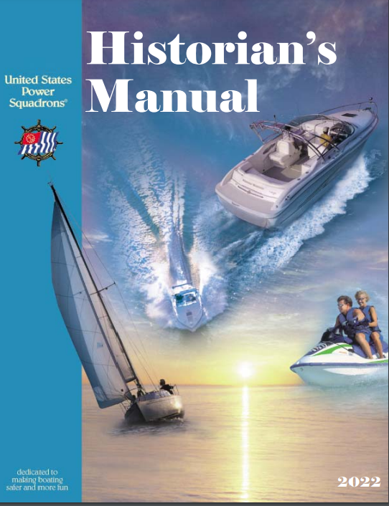
2
Notes:
In addition to this Power Point, there is a Historian Manual
Both can be found on the HADCom webpage

Slide 3
Annual History Report
3
DB2000 & H-701 Form
Notes:
Annually the Squadron Historian fills out a form H-701 using DB2000. Typically this is done the first 30 days following COW. The District Historian fills out H-702 form using DB2000. The difference between Squadron and District Histories will be covered later. Any word denoting a unit of United States Power Squadron, America’s Boating Club used in this power point shall apply equally to either unit be it squadron or district as the context may require.

Slide 4
Topics to be covered
4
Getting ready
How to write a history
How to submit a history
How to find a previously submitted History
Finding help

Slide 5
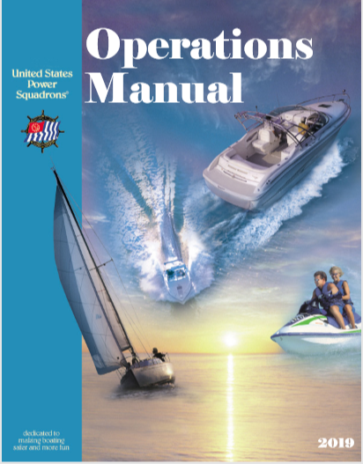
Getting Ready
5
Read Operations Man
5.50
4.40
Notes:
It is recommended if you have not read the Operations Manual Chapters 5.50 for Squadron Historians and 4.40 District Historians do so now

Slide 6
Needed Items
6
Minutes
Roster
Newsletters
Squadron Calendar
Reports
User password
Installation of the MQ Series Client
Notes:
As recommended by the Operations Manual, Minutes, Roster, newsletters, squadron calendar and reports especially education report will give you the information that goes into the Annual History . Electronic or word files will allow you to cut and paste the information, The User password is needed to submit the history when completed and download the latest squadron database and the "MQ Series Client" software be installed.

Slide 7
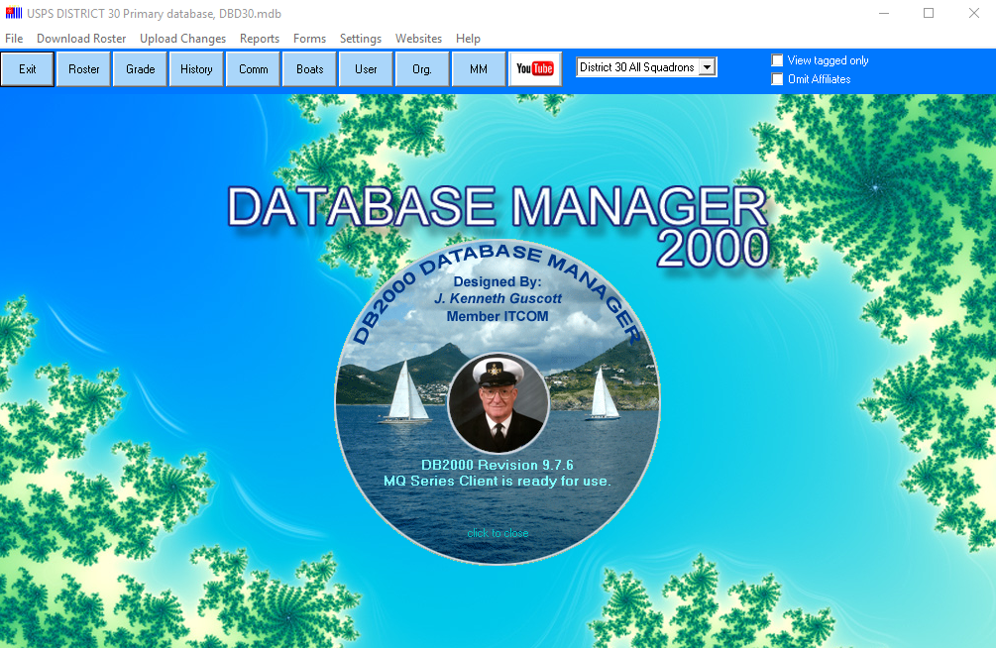
Acknowledgement
7
Notes:
WE would like to acknowledge J. Kenneth Guscott for designing DB20000. The help section of DB2000 is well written and very helpful. Some comments in later slides come directly from the help section. P/D/C Ken Guscott, JN of 22/Anna Maria Island; DB2000 was originally developed for his squadron before spreading to his district and then the national organization. DB2000 version number is displayed along with the message, “MQ Series Client is ready for use.” If this message is not displayed, the user needs to go to the DB2000 Downloads webpage and download & install the MQ Series Client. Installation instructions are on the DB2000 Documentation webpage. Current and last version is 9.7.8 update 2019

Slide 8
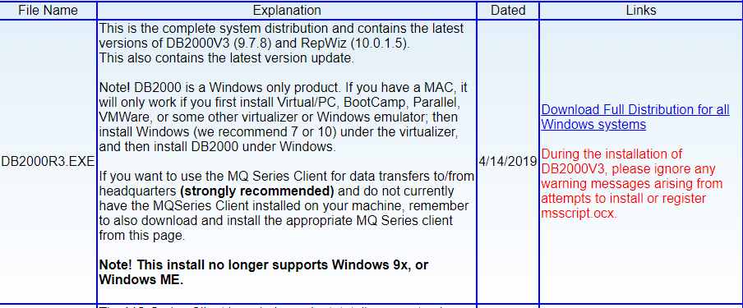
DB2000v3 updates
8
Notes:
Screen shot from DB2000 updates from DB2000 Folder under site index.

Slide 9
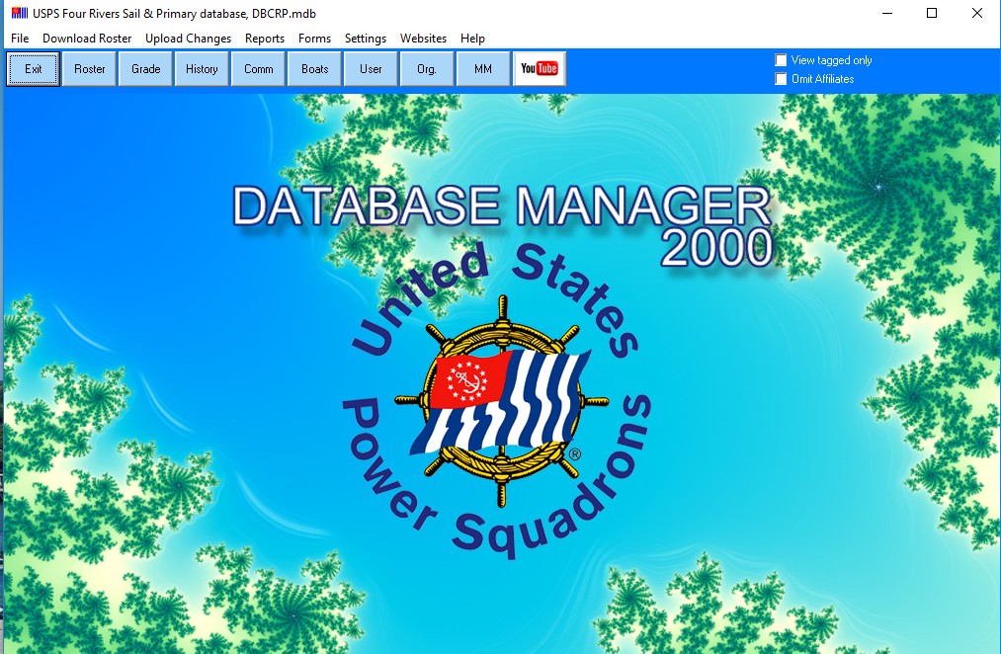
DB2000 Main Screen
9
Notes:
Main Screen of DB2000, The "hotspots" on the control buttons and menus will take you to the various topics concerning them. Next we take a closer look.

Slide 10
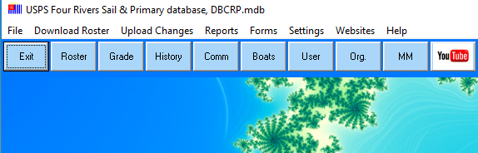
Control Buttons
10
Notes:
Main DB200 screen zoomed into Settings is used to enter User Authorization and password, Download Roster will get you your latest squadron database, and Forms will get you to the H-701 Form. If you have multiple databases installed, Squadron and district File will allow you to swap or change database to the correct one.

Slide 11
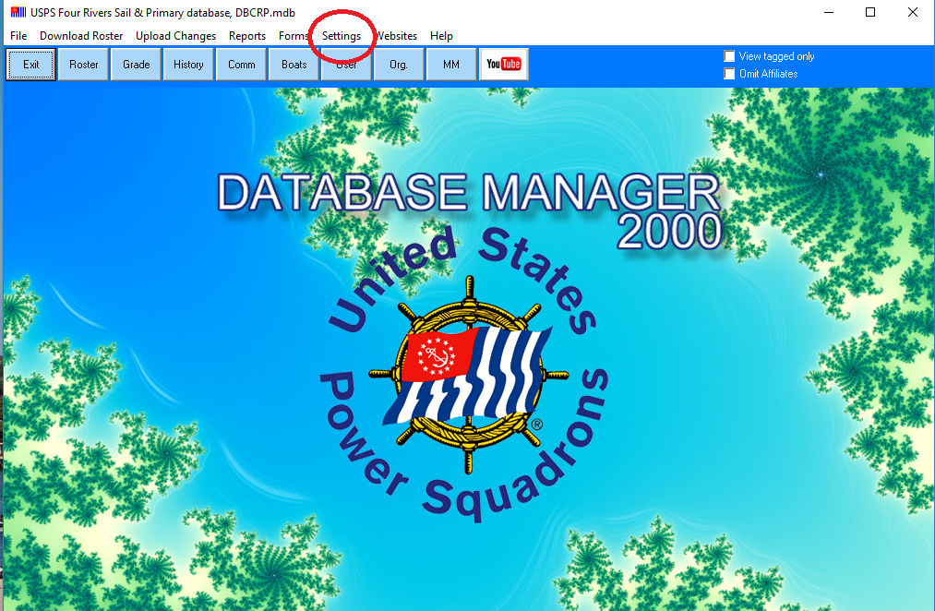
11
Notes:
First menu is “Settings”, see the red circle and click on “Settings” a drop down-menu will appear.

Slide 12
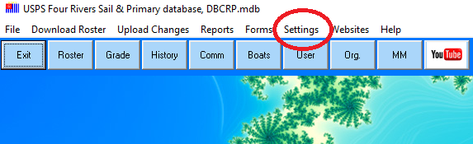
Settings
12
Notes:
Here we have zoomed into just the menu bar, showing “Settings” a little clearer

Slide 13
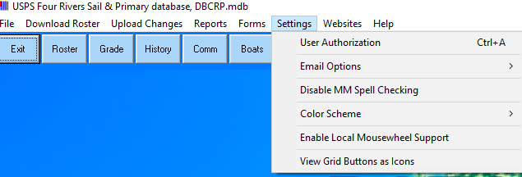
13
Settings Drop Down Menu
Notes:
We have selected “Setting” a drop-down menu has appeared. On the drop-down menu select “User Authorization”. A pop-up box will appear.

Slide 14
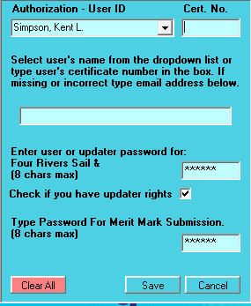
14
Notes:
The Authorization User ID, Top left box you can type your surname and all with the same surname appear , select your name. Or you could use the down arrow and scroll to your name. Once your name is selected it should auto populate your certificate number and email. In this figure they were intentionally removed. Enter the squadron USER password. The UPDATER password will work but is no longer required.

Slide 15
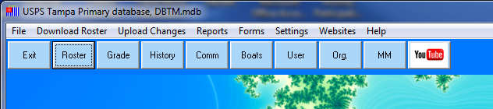







15
Import Download Roster
Notes:
Direct downloading from the HQ computer, requires that the "MQ Series Client" software be installed. If this software is installed, the roster can be directly down loaded. First, from the menu select "Download Roster". This will start the downloading process. Status screens display in the lower left-hand corner to indicate progress. The seven images will appear one at a time as the download progresses
On the DB2000 main page Click on “Download Roster” software will verify user rights and download latest roster, follow the steps to install roster. You are now ready to start entering your squadron history

Slide 16
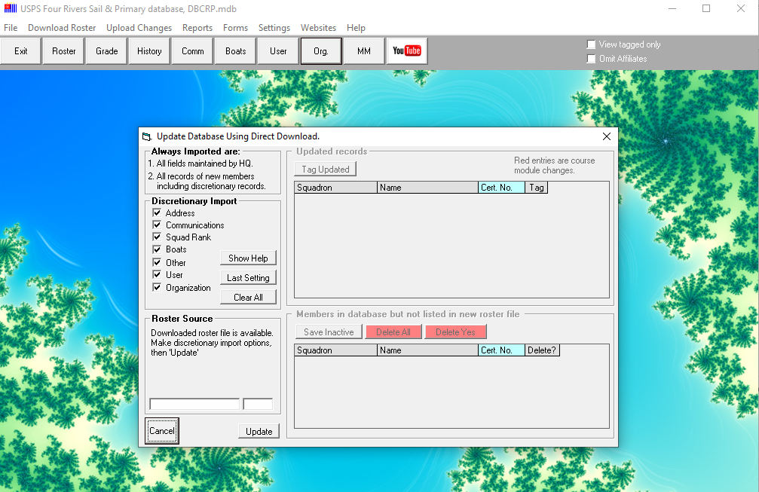
16
Notes:
When download complete this window pops up,, Click UPDATE

Slide 17
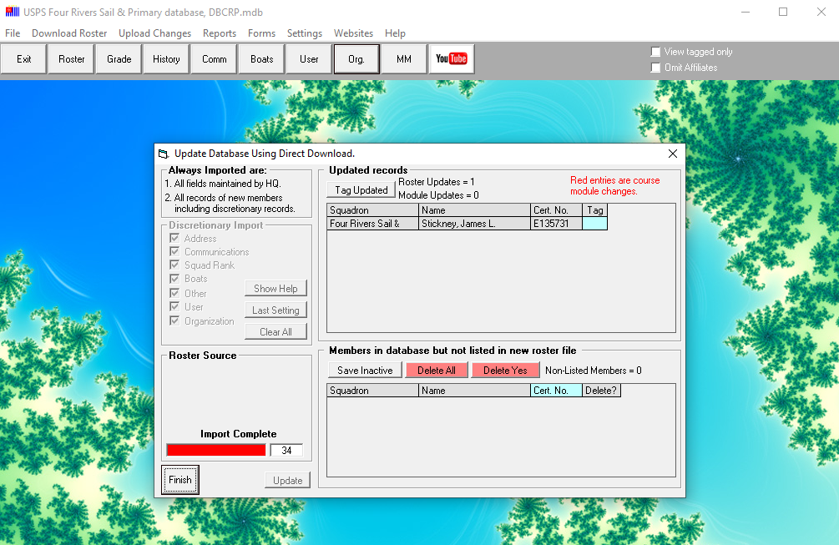
17
Notes:
The next window, click “Tag Update” click Finish
You now have the latest roster

Slide 18
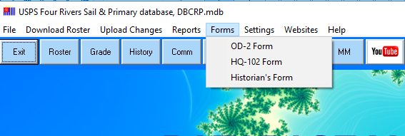
Squadron Form(s)
18
Notes:
This Image is with a squadron database open, file name is DBCRP.mdb the DB is for Data-Base and CRP my squadron initials or (Tag). If using UPDATER password all three forms are available select the correct one.

Slide 19
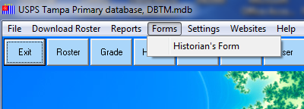
Squadron Form
19
Notes:
– If the Historian is using the User password, note that there are screen differences. The only form listed will be the Historian’s Form. Also, the Upload Changes button will be missing from the menu bar. The absence of the from the menu bar does not affect the submission of the History Report.

Slide 20
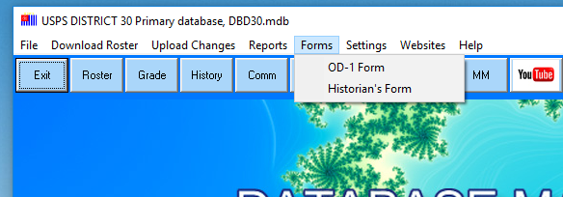
District Form(s)
20
Notes:
The image is my district data base, the file name is DBD30.mdb same format in name D30 being the district. Users with multiple databases please verify you are using correct data base. IF needed go to “File” select “Database Operation” and change primary database.

Slide 21
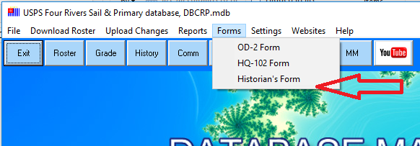
Open Historian’s Form
21
Notes:
On the DB2000 main page click on “Forms” and from the drop-down menu select “Historian’s Form”. Just click on Historian’s Form. The guide will open in a new window.
There are differences between the squadron and district reports. Let’s start with the Squadron Report (H-701) screen. We will discuss District reports, form H702 after covering the squadron form.

Slide 22
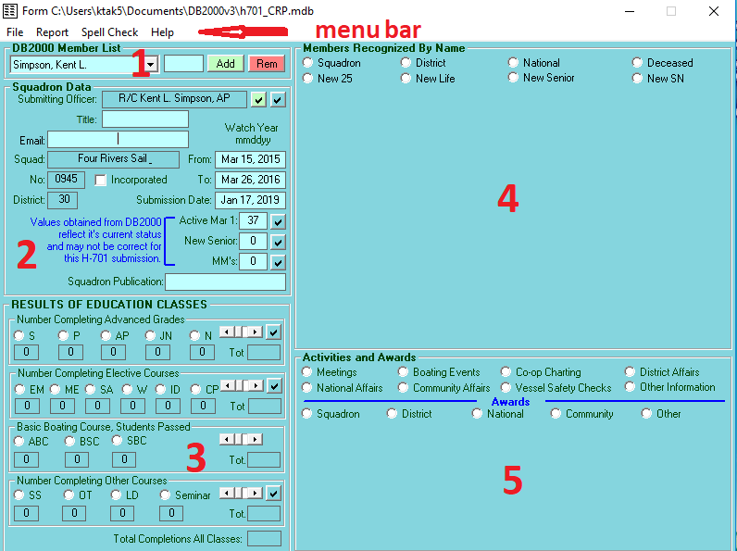
Notes:
Viewing the whole screen at once it is hard to see some details, so we will enlarge each section as we go. The Screen divided into 5 sections. Above section 1 is a Menu bar with File, Report, Spell Check and Help.
Section 1 is a drop-down menu for everyone in your database be it squadron or district.
Section 2 contains Report Identification data such as the name of the historian, squadron identification, change of watch dates and membership statistics.
Section 3 is a tally of students completing Education Classes.
Section 4 - Member Recognized Name.
Section 5 - Activities & Awards. The Historian’s Report is built by clicking on each radio button and completing the pop-up fields such as squadron/district officers, members serving in district/national positions, etc. As with the rest of DB2000, pressing Help on the menu bar will present explanations specific to the section/field that in which the cursor rests.

Slide 23
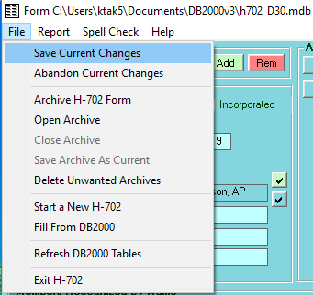
Notes:
On the Menu bar click File on the drop-down menu Click ”Start a New H-701” Once COW dates are entered in Section 2 “Fill From DB2000” will fill or auto populate many fields in sections 2, 3 and 4. SAVE Current Changes often as you work and always before exiting the Historian’s Form. Do not confuse the SAVE function with ARCHIVE. Archives are discussed later. For now, it is important to know that the current Historian’s Form is stored in a separate database from the roster database. Once the current year’s history has been started and the fields have been auto-filled, the DB2000 roster can be downloaded without impacting the Current Historian’s Report.

Slide 24

Current Historian Report
24
Notes:
Highlighted in red is the automatically generated file name for the current Historian’s report file name \h701_CRP.mdb. Where h701 denotes a squadron form the CRP is the squadron (Four Rivers) tag. A district file name would use h702 and district tag would be D nn.

Slide 25

25
Notes:
Report drop down menu “Preview and Print” prints out form H-701 and data entered. Submit Report Via Website Uploads the H-701 file to HQ computer as a text file
Menu Bar Spell Check, spell checks and Help, Open help specific to the H-701 Form and is very well written and helpful. If you are the main screen it displays generic help, not help for Historian Form.

Slide 26

Section 1
26
Notes:
Section 1, DB2000 Member list has all the members in your squadron database. Large squadron or district databases may have a 1000 plus names, it is easier to type your name. All members with same surname will appear select preparers name. Or you can click down arrow an all names appear alphabetically just scroll to your name. Click “Add” your name and data will populate your name, rank and email in next section as they are entered in your database.

Slide 27
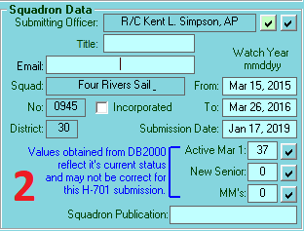
Section 2
Notes:
Section 2 verify populated data is correct. Click the Check mark next to submitting officer to auto populate submitters data If your squadron Incorporated, click the box. Enter watch year mmddyy, will covert to correct format. Enter your squadron publication name. in the menu bar under “File” select “Fill from DB2000. Note the text in blue, Values obtained from DB200 reflect its current status and may not be correct for this submission. Active Mar 1; New Senior, and MM’s, just click check mark and it populates what DB2000 has. MM’s may show zero: These values are obtained by DB2000 if values are incorrect. They can be manually entered to override the auto-filled values. This way, the total number of MM received could be entered; just don’t click the check because the auto-fill will overwrite the manual entry. SUGGESTION: It is far easier to ask the commander or merit mark chairman how many merit marks were approved, add 1 for the commander and enter the total.

Slide 28
Notes:
On the Menu bar click File on the drop-down menu Click ”Start a New H-701” Once COW dates are entered in Section 2 “Fill From DB2000” will fill or auto populate many fields in sections 2, 3 and 4. SAVE Current Changes often as you work and always before exiting the Historian’s Form. Do not confuse the SAVE function with ARCHIVE. Archives are discussed later. For now, it is important to know that the current Historian’s Form is stored in a separate database from the roster database. Once the current year’s history has been started and the fields have been auto-filled, the DB2000 roster can be downloaded without impacting the Current Historian’s Report.

Slide 29

Section 2
Notes:
Section 2 with date zoomed in, showing date in numeric Format
032421 auto shows as Mar 25, 2022

Slide 30
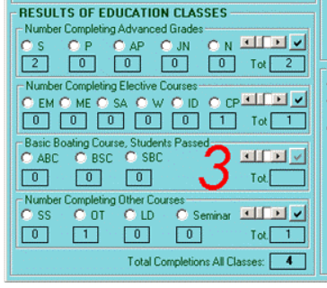
Section 3
30
Notes:
Section 3 Just click in checkmarks it will import correct numbers, or They can be manually entered to override the auto-filled values; just don’t click the check because the auto-fill will overwrite the manual entry. Exception Public boating course select course(s) taught and enter # of students per SEO or Ed reports.
Tip: if you mouse over the abbreviations the full name appears next to it.
Hovering mouse pointer over SS it shows Skipper Saver.

Slide 31
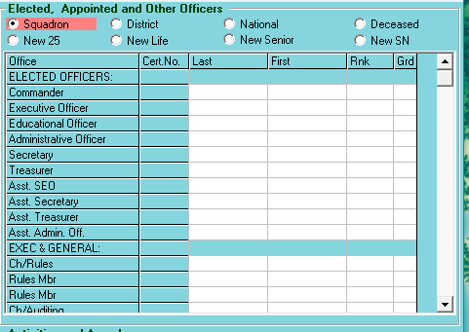
Section 4
31
Notes:
Section Four, members recognized by name. Uses name drop down list from section 1 Select one of 8 categories and will bring up a box for members. Clicking Squadron will give you Bridge and Committees. Upon opening it will import information submitted on your squadrons’ OD2. The more information on OD2 the easier this section is to complete.
Without an update DB2000 will not support the changes that the latest model bylaws support
Categories; Squadron: Members having squadron office. District: Members having district office. National: Members having national office. Deceased: Members that died during the report period. New 25: Members reaching 25 year membership anniversary. New Life: Members receiving their 25th merit mark. Life member. New senior: Members receiving their 5th merit mark. Senior member. New SN: Members achieving the grade of senior Navigator.
Each of the eight categories, when you click on title it is high-lighted and new pop up box
In this slide “Squadron has been selected, the name is highlighted and Officers for squadron, It will show what was submitted on OD-2, Cert#, Name Rank and Grade

Slide 32
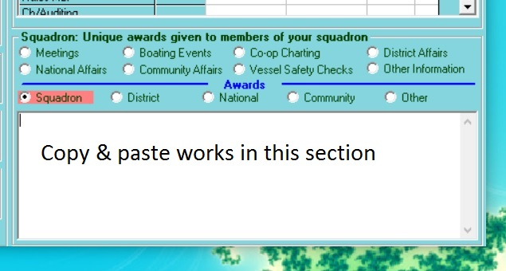
Section 5
32
Notes:
Section 5 is the Activities and Awards.
Activities Categories; Meetings, Boating Events, Co-Op Charting, District Affairs, National Affairs, Community Affairs, VSC, and Other Information.
Awards Categories; Squadron, District, National Community and Other
As in Section 4 clicking on individual category the title is high-lighted and new window appears for entering text. Once a category has been selected the Activities and Awards is replaced by a more detail description for that category
Example Category Meetings: Number of Exec boards and General, Lunches, Dinners, Cow, Guests. I cut and paste from minutes, date, location, number attending and a quick highlight.
You may wish to keep a word file as the year goes on and take the write-ups on awards and meeting as they happen then use the COPY and Paste function. Depending of software and version some formatting maybe lost.
TIP: The formatting capabilities of the narrative text box are quite limited. If the text is originally prepared in "Wordpad" or "Notepad" and then pasted into the narrative box, tabs will be maintained.
Adding a member name to a narrative
Click on the "Add" button. This places the name on the clipboard
Locate the cursor at the insertion point and type "Ctrl + V" or "Shift + Insert" to paste.
Note: If you chose to insert a name while typing narrative the cursor should already be positioned. Rank, name and grade are inserted and may be edited as necessary for the report.
Note: You could also right click the mouse to raise the Windows® edit dialog. Click "paste’ to insert name. This edit dialog may be used for any cut/copy/paste narrative activities.

Slide 33
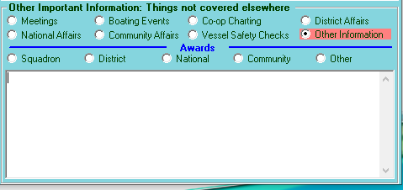
Section 5 “Other Information
33
Notes:
Other Information,
Education not recognized or covered in Section 3 ; Seminars and Boat Operators Certification as examples
Non-Traditional Offices, Simplified structure from new model bylaws
Merit Marks ; list of members awarded a merit mark this bridge year and their total number of merit marks
Remember “Cut & Paste” works here

Slide 34
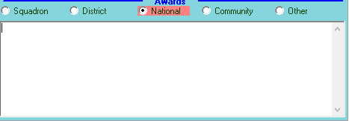
34
Division 1 honorable mention growth award
Notes:
Example of an award received by squadron from National, Division 1 honorable mentions growth award, This is adequate but does it tell the full story?

Slide 35
Division 1 honorable mention growth award
4 divisions based on membership:
1: 114 + members. 2: 75-114 members.
3: 45-74 members. 4: 44 or fewer members
Positive growth and 87% or better retention.
Grand Lake in Division 1 had a 2.7% growth with 96.4% retention.
Notes:
Division 1 honorable mention growth award
There are 4 divisions based on membership: 1: 114 + members. 2: 75-114 members. 3: 45-74 members. 4: 44 or fewer members. To get a award you must
have positive growth and 87% or better retention.
Grand Lake in Division 1 had a 2.7% growth with 96.4% retention.
Tells what award was received, the criteria and their results. Details make for a better narrative of the facts and gives a future reader a full explanation of what happened to earn this award.

Slide 36
H-702 District Annual Historian Report
36
Differences between H-701 & H-702
Notes:
The next three slides will show the slight differences between Squadron and District Annual History Reports. Entry data, printing and submitting work the same for both.

Slide 37
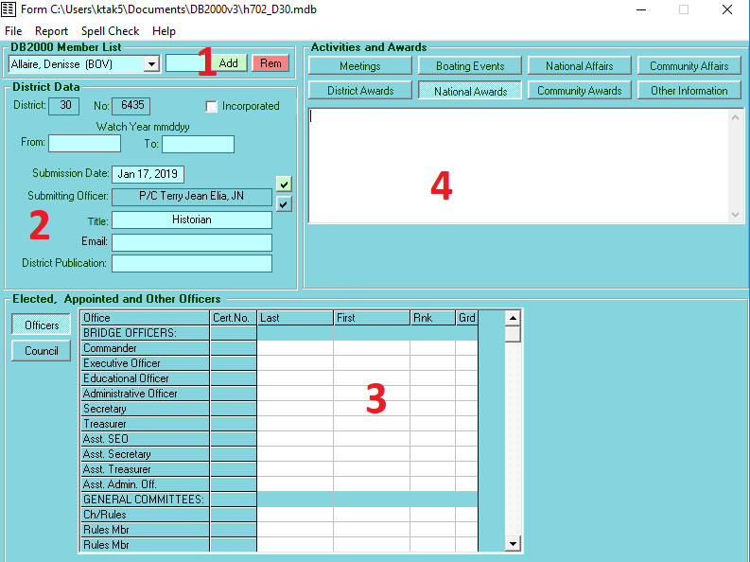
Notes:
Only four section
Menu Bar is the same as H-701, with File. Report, Spell Check & Help
Section 1 Member list, drop down of all members in database
Section 2 Different layout and missing Active Members # and Merit Mark info
Section 3 Officers, The districts elected and appoint members. Council Squadron Commanders of the district.
Section 4The upper right frame has the area in which narrative describing the district’s meetings, activities and awards is entered. Select the category desired and type in the appropriate information. Simple formatting may be used such as line feeds, quotes etc. Data may be cut and pasted from other documents with some formatting features getting modified in the process. Categories
Meetings:
District Conferences, Council meetings any ad-hoc meetings etc.
Boating Events:
District cruise & rendezvous etc.
National Affairs:
Attendance and participation in national events.
Community Affairs:
Attendance and participation in community affairs,
Awards
District Awards:
National Awards:
Any awards received from national for district activities and performance.
Community Awards:
Any recognition from communities in the district pertaining to the district as opposed to individual squadrons.
Other Information:
Any pertinent that is not covered in the other categories.

Slide 38
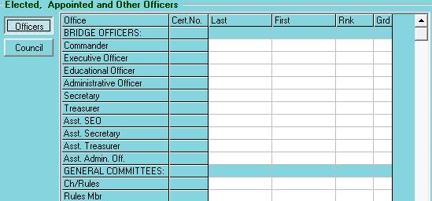
38
Notes:
As with the H-701 form once Section one is completed, Go to “File” and select Fill From DB2000. All data entered in district’s OD-1 form will auto populate the appropriate fields Sec 3
Fill in missing data as needed. Scroll Bar on side to get to other committee and appoint positions

Slide 39
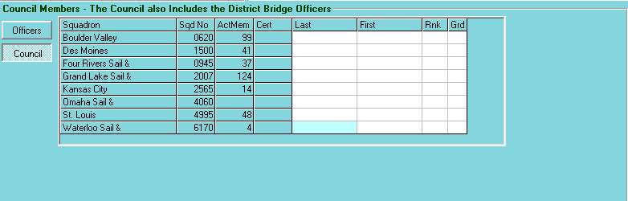
Council Members
39
Notes:
Council Members- The Council also includes District Bridge Officers. In previous screen District Officers were added. Now we are adding Squadron Commanders . Here the names were removed, they had auto populated. Missing names can be added using the Member Data list in section 1

Slide 40
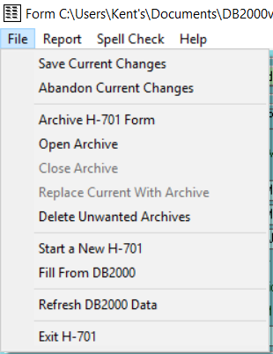
Save your work
40
Notes:
Data entry is complete. Go to “File” select “Save Current Changes”

Slide 41
Review your work
41
Notes:
Hint; Run Spell Check first!! Click “Report” and select “Preview and Print” a pop up will appear

Slide 42
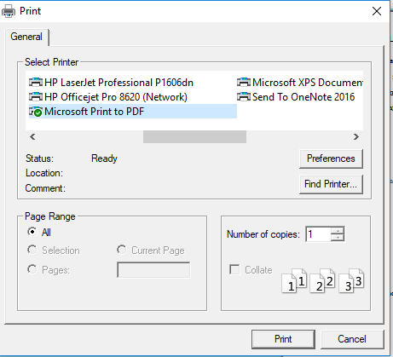
Print
42
Notes:
The Pc’s normal print popup appears. I have selected “Print to PDF” and click “Print.” After reviewing, email PDF to Exec Board for their review and approval. Make corrections as needed. Once all corrections are made. Print a final copy prior to submission. This file copy can be either a paper or an electronic copy.

Slide 43
Submit
43
Notes:
Click “Report” and select “Submit Report Via Website”. DB2000 uses the MQ Series Client to connect National’s mainframe where the upload program runs.

Slide 44
44
Notes:
If this pop up does not appear check your virus protect or pop up blocker software.
Verify your email address,. It tells the file name it is looking for and where to find. Use the “Browse “ button and select correct file, click “Enter: or just select the file name and use copy & paste.
Once email and correct file selected click “Submit Historian” The file will upload to the HQ computer
If DB2000 fails to connect, ensure that you have installed the MQ Series Client. SAVE Current Changes and exit the Historian’s Form. Then, open the Help menu and select About. If the MQ Series Client is not installed, download and install the software from the DB2000 Downloads webpage. The DB2000 Documentation webpage includes instructions on installation. Both links are on the Help menu. If more assistance is needed, email the DB2000 Support Team at db2000@usps.org.

Slide 45
Archive
44
Notes:
– Archive the completed Historian’s Report as soon as it has been submitted! Archives will be saved to your DB2000 data directory and can be used to recreate printed reports.
The archive is named automatically.
H701 denotes a squadron; district would be a h702
TM is the squadron (Tampa) initials (tag)
District would be Dnn
18 the beginning of the watch year ;last 2 digits
19 the ending of the watch year; last 2 digits
A signifies that this is an archive file

Slide 46
46
Notes:
Opening an archive, closes the Current Historian’s Report (that’s why we wanted it SAVED prior to doing this) and opens the selected Historian’s Archive.
All of the Historian Report functions work the same allowing reports to be recreated or data to be corrected and resubmitted. When done with the archive, SAVE (Current Changes) and Close the Archive. The current year’s Historian Report will be re-opened.

Slide 47
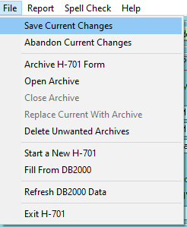
Notes:
Before opening an archive, SAVE your Current Changes. We’ve gone through this earlier

Slide 48
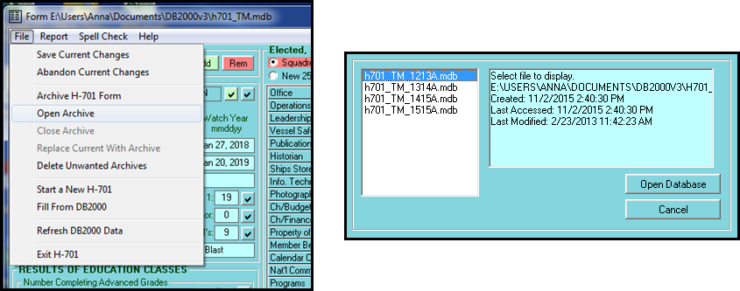
Archive File Naming
47
Notes:
When opening an archive, all of the archived Historian Reports are displayed for selection. Database header information is also displayed such as the date that the archive was created along with the dates that the archive was last accessed (read) and modified. The Historian makes his/her selection and then clicks on the Open Database button.

Slide 49
Reminders
48
Do use same PC
Do use Windows PC
Do Start Early !!
Do Review Help section
Do verify latest version of DB2000
Do use Updater password
Do ask for help
Do report problems
Do suggest improvements
Notes:
Start early is important, – Begin prior to the change of watch in order to use auto-fill. If district, start prior to the first squadron change or watch. Best yet, start the new year after the change of watch and document the history throughout the year.

Slide 50
More Reminders
49
Do use “Cut & Paste”
Do include full names and ranks
Do add personality , fun things
Do use the “Other” under Awards
Do use spell check
Do print a copy when completed
Do review archived histories

Slide 51
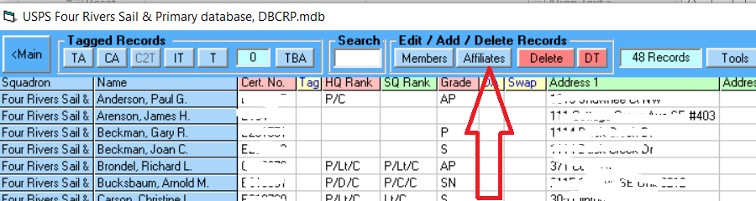
Tip
50
Notes:
Start early In Section #5 take advantage of copy and paste. If someone created a short quick write up and advent or award presentation. Just copy and paste it to the best category in section #5
Review your work
Sometimes when we are doing the History we desire to enter a member(s) who is not in database ( Roster) How to get them back into database.
We suggest using the Affiliates, found under ROSTER

Slide 52
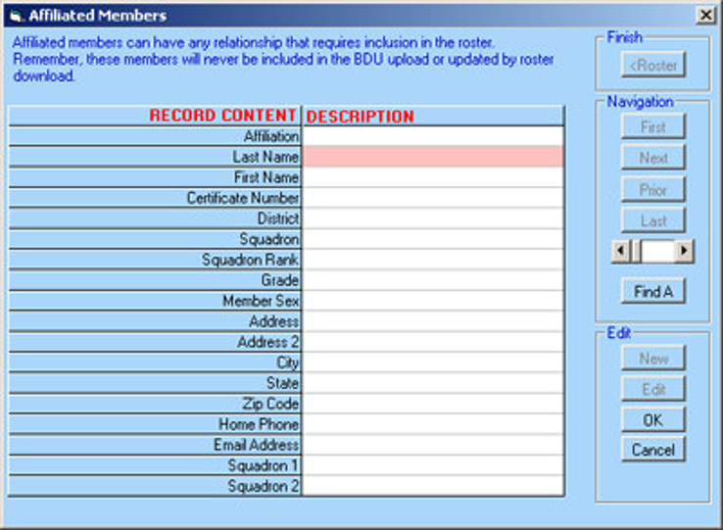
Notes:
Affiliated Members
The user may add anyone to the roster as an affiliated member. This is a handy way of including non squadron members in mail lists or for allowing merit mark recommendations to be made for members of other squadrons. To add a member, click on the "Affiliates" button to open the dialog.
Click "New" to begin
Affiliate relationship
The top row defines the affiliation and there is a list of suggestions. If the list does not contain a suitable description, type in whatever that is. If the field is left blank, DB2000 will define it as "Other" because the field must have an entry.
Fill in Name & Certificate number

Slide 53
Report Problems
52
Heritage & Documents
Notes:
Report issues to the Heritage & Protocol Com https://www.usps.org/index.php/departments/15000/15890

Slide 54
Finding submitted Histories
53
Search
Notes:
History Search
http://www.usps.org/php/hap/
Or go to Heritage & Protocol Com Page

Slide 55
Submit File
54
File name = year account#.txt
Example 2015950.txt
Notes:
National renames the uploaded file for storage and retrieval.
Once the file is uploaded the file name Year account# . Text example 2015950.text Where 2015 is the watch year History report was for and last four digits is our squadron account code. Filename is generated automatically. If you send twice the second file overwrites the first file and both files will be the same. Please let the committee know it will be cleaned in next house keeping sweep

Slide 56
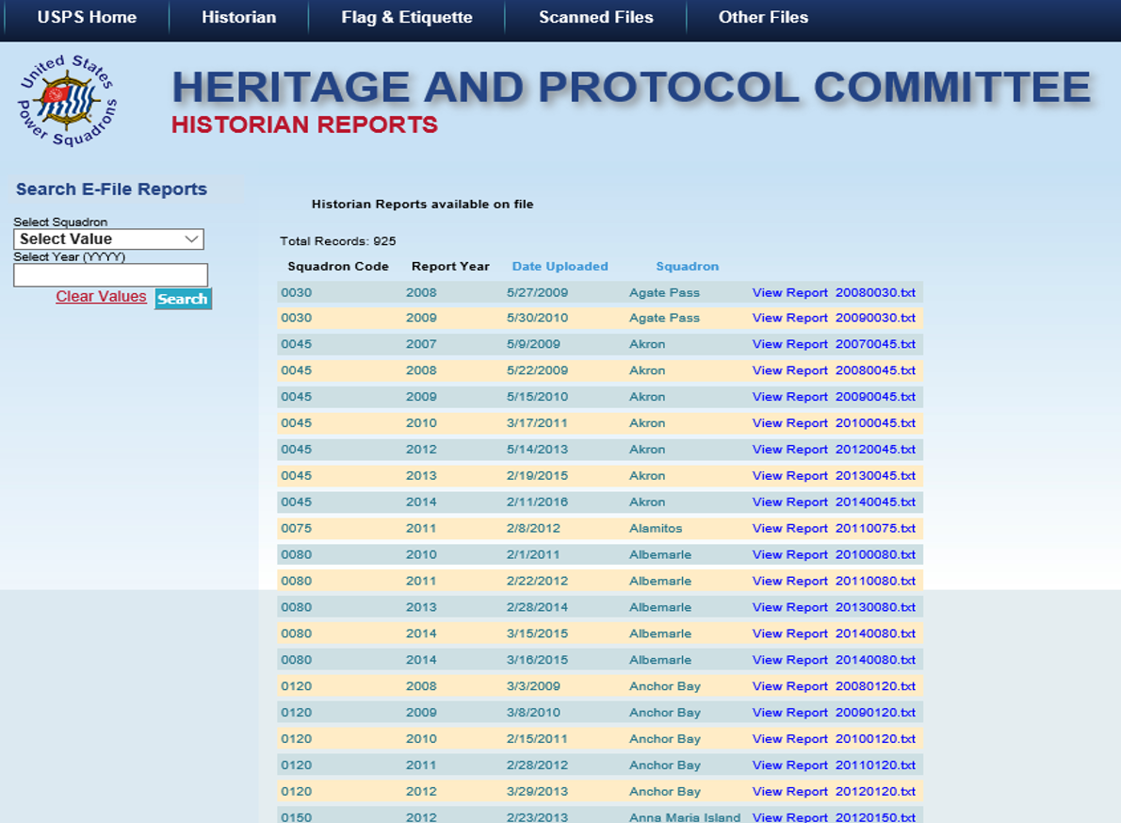
Notes:
Histories filed with DB2000 and submitted online are found under “OTHERS” same file format. Please review once it is uploaded. IF you have a mistake. Fix with DB2000 and resubmit it will have the same file name and will overwrite bad one. You will have two entries. Example 20140080 is listed twice clicking on both will give you the same file. Please let us know and we can delete one.
Under top box “Selected Values” clicking will give you a drop down of all squadrons to narrow your search. Or search by four digit year
One you find your squadron click on “View Report

Slide 57
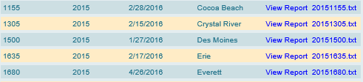
56
Notes:
A closer look at a few archived files

Slide 58

scrolling
57
Notes:
At the bottom of screen is a scroll bar, Per Page allows user to change how many histories per page, just use drop down. The “end” button takes you to the last Histories. This is where you find the Histories submitted by Districts

Slide 59
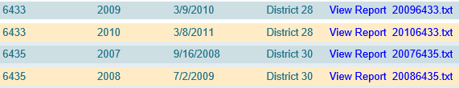
58
Notes:
Screen shot of some of the District Histories submitted. Same formatting as squadron

Slide 60
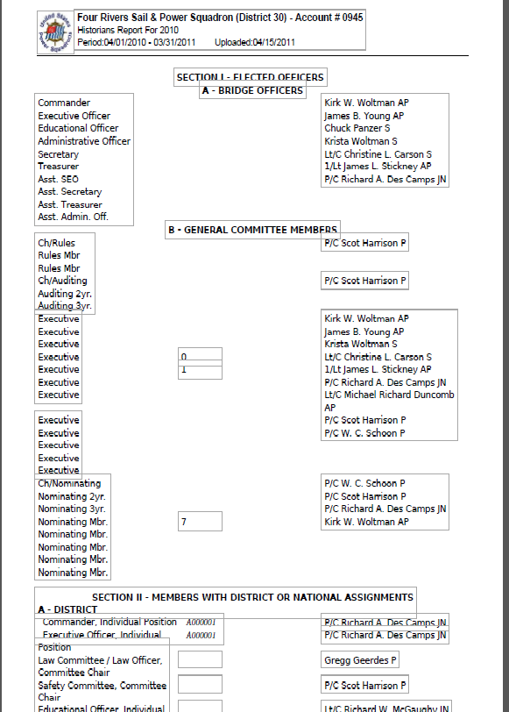
59
Notes:
A pdf file will open in new window,. You can Right click and save as. If desired. This one is four pages some are as large as ten pages
Cert #’s removed

Slide 61
Thank you
60
Copy of this power point can be found at
http://www.d30usps.org/Completing Electronic History revised.pptx
Notes:
This power point was written by D/C Kent Simpson, AP of D/30 and technical review by R/C Anna Morris, SN Tampa D/22

